Slide 1

Gender/Race wage gap in Miami Dade County
Supervised by
Dr. Sean Mondesire, Ph.D.

Slide 2
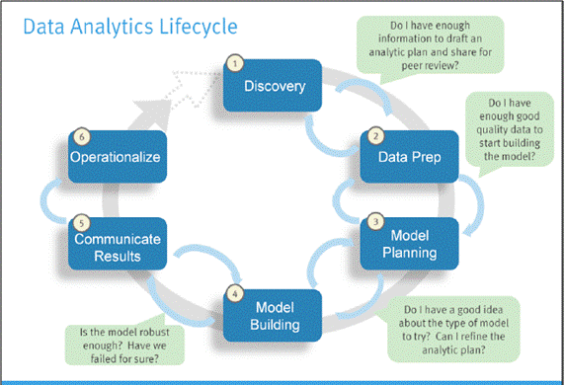
Data life cycle
Phase 1: Discovery
Phase 2: Data Preparation
Phase 3: Model Planning
Phase 4: Model Building
Phase 5: Communicate Results
Phase 6: Operationalize

Slide 3
Contents
Problem Statement
Data collection
Design and Implementation
Analysis
Results
References

Slide 4
Problem Statement:
Which Gender/Race has more wage Gap in the Miami Dade County?
Develop a model for predicting the Average monthly salary for Miami Dade County by using Time Series Analysis.
By using this approach, we can identify the percentage wage gap among male and female.
We can also identify the wage gap by racial group.

Slide 5
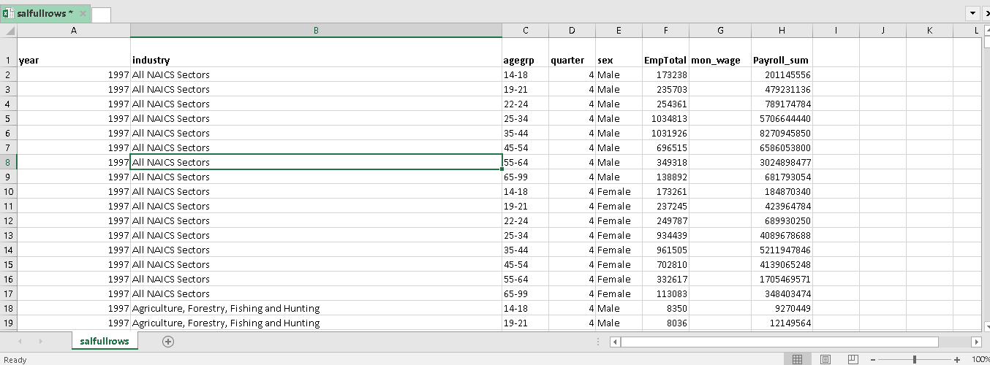
Data Collection:
The data is collected from 1997-2018 to predict average salary in all occupations of Miami Dade County.

Slide 6
Design and Implementation:
To predict average monthly salary of Employees in Miami Dade County, ARIMA Model is being used for predicting the salary for next following years.
Time Series Analysis – Auto Regressive Integrated Moving Average
To Implement the design, R language was used to create the model.
Computer languages: R Studio 1.1.463
Libraries: readr, tidyverse, dplyr, tseries, forecast.

Slide 7
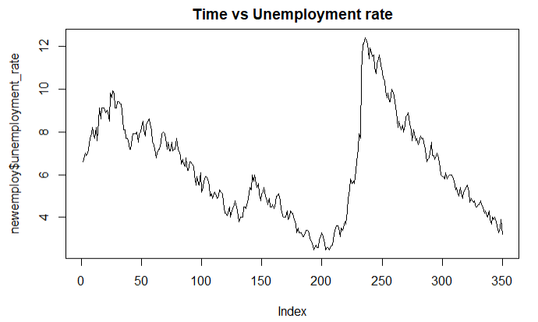
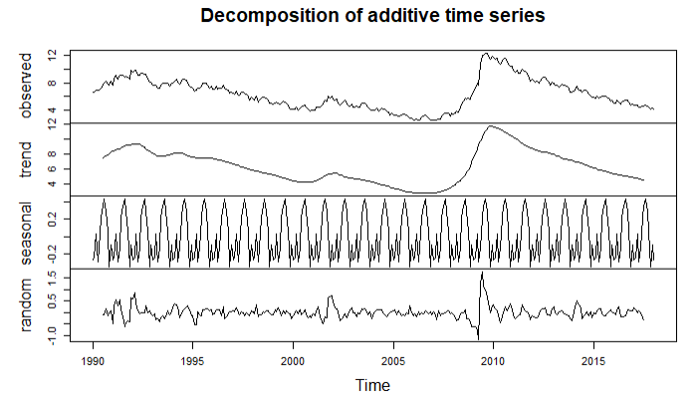
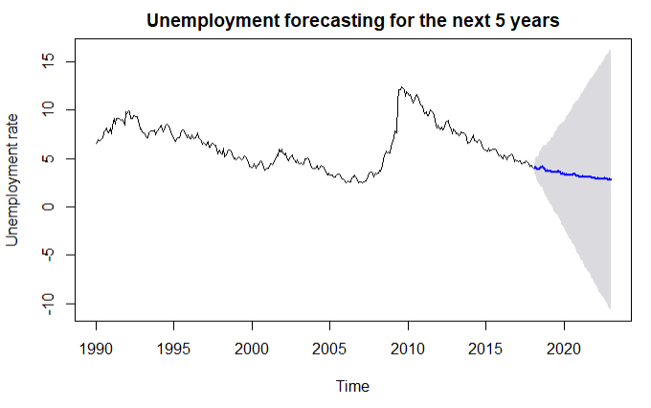
Time series Analysis for unemployment
Collecting and tidying the data
The data is structured and it had been cleaned. The actual plot is shown below Figure represents the unemployment rate from 1990 to 2019. For anticipating this investigation, Time Series Analysis is utilized to figure the unemployment rate. The outcomes demonstrate that there is a descending and upward pattern appeared in Figure
This had been anticipated the unemployment rate for next five years. The chart underneath demonstrates that there is an abatement of 2.845611% in the unemployment for the following five years.
The shaded area demonstrates that there is an expanding blunder for one years from now. The non-seasonally balanced unemployment rate for Miami-Dade County was down to 4.1% in August 2018. Year-over-year there was a 1.0% lessening, as the unemployment rate for January 2016 was 5.1%.

Slide 8
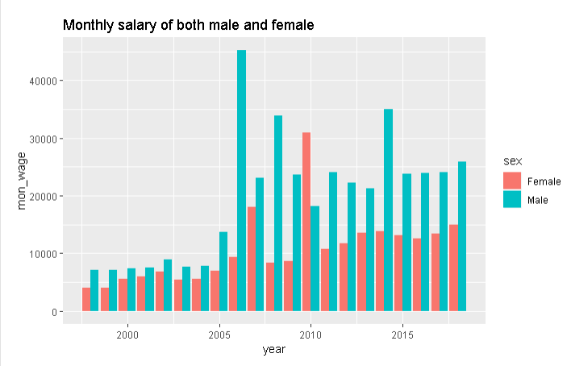
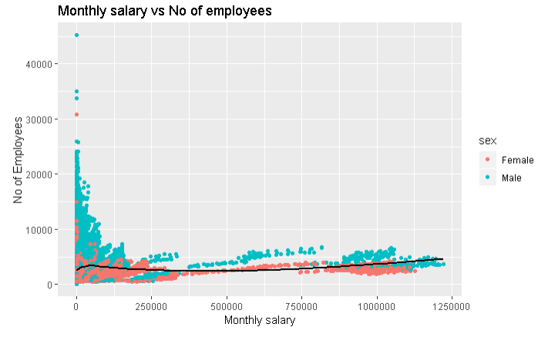
Time series Analysis for Gender wage gap:
Forecasting Average monthly salary for both genders
The first way is to look at the data is to examine the pay of men and women across all jobs in the MDC. To do that, take a look at the pay for salaried, full time employees from 1998-2018. Here is a plot of the salaries for men and women: it shows, in a glance, what they’re getting paid monthly. This gives us a rough idea of how men and women are paid by the MDC.

Slide 9
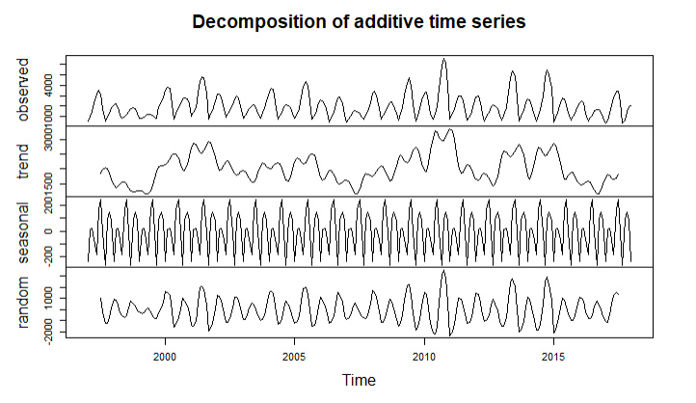
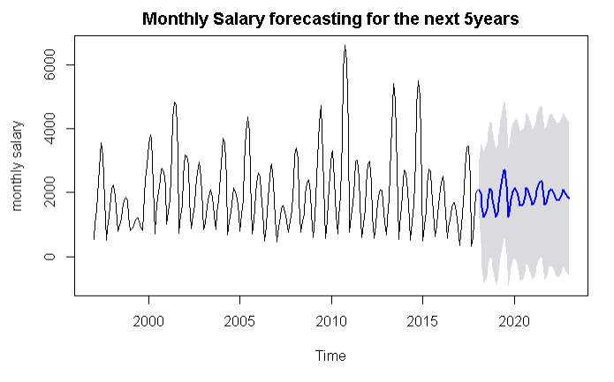
The outcomes demonstrate that there is a downward and upward pattern
Forecasting monthly average Salary for both genders as shown in Figure 7. The Predicted Average Monthly Salary for both genders is $ 1756.245

Slide 10
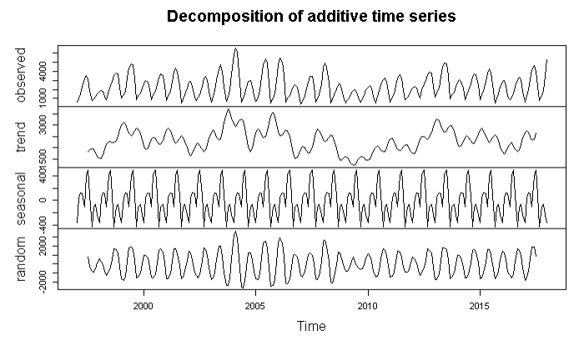
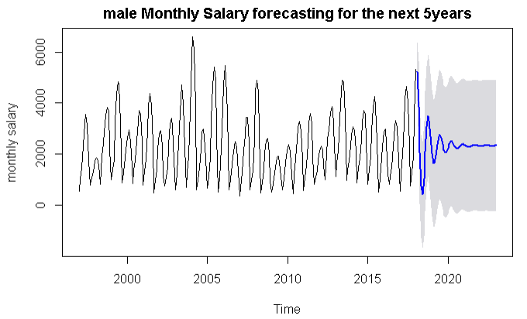
Forecasting for Male Average salary
By using Time series analysis, we are forecasting male salary for next 5 years. The decomposition of gender pay gap for female is shown in below graph

Slide 11
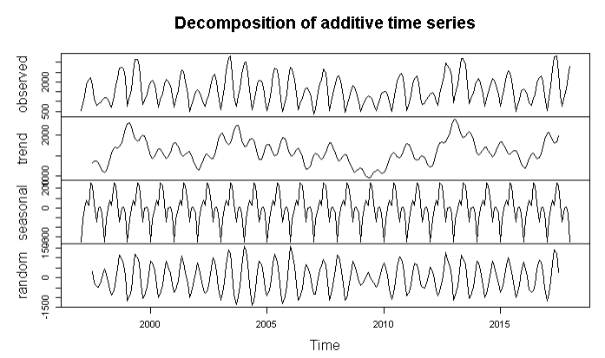
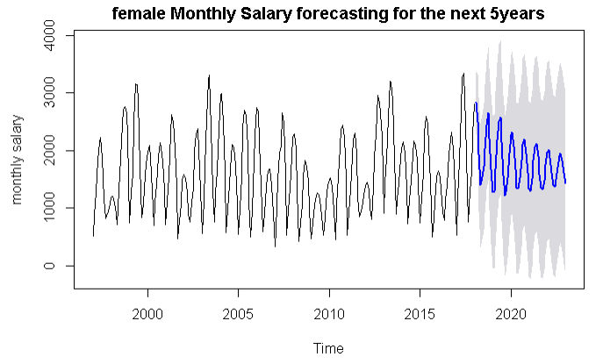
Forecasting for Female Average salary
By using Time series analysis, we are forecasting female salary for next 5 years. Let’s look at the trend in female salary.
By Analyzing Male and Female Average Salary, we found that the Average Male Salary is 1.788439 times of Average Female Salary.
The average woman’s monthly pay is $ 1607.044 lower than the average man’s. Stated differently, the average woman makes 56 cents for every dollar the average man makes.

Slide 12
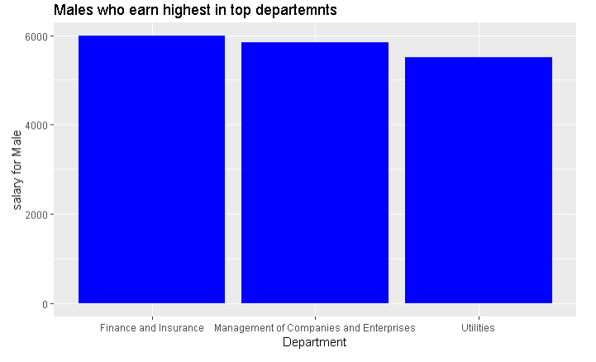
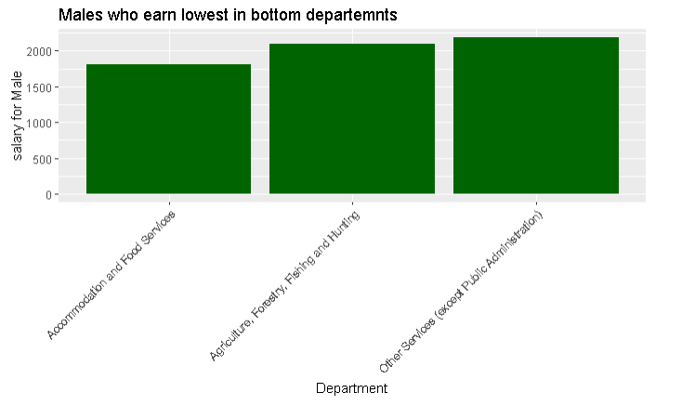
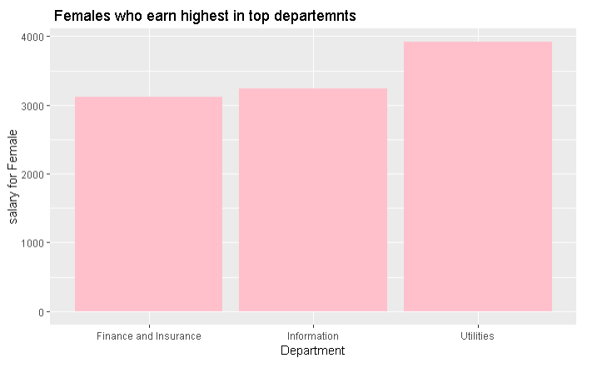
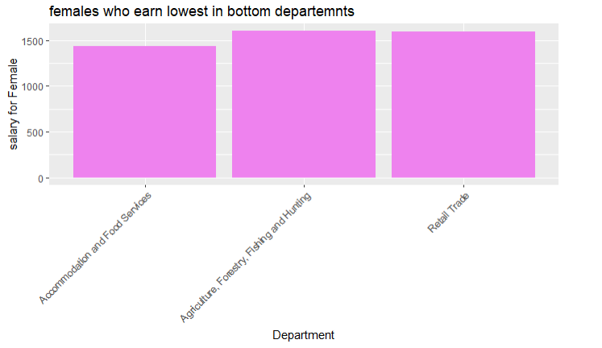
By aggregating, the salary of male and female we sorted the top 3 departments with highest and lowest paid in Miami Dade county.

Slide 13
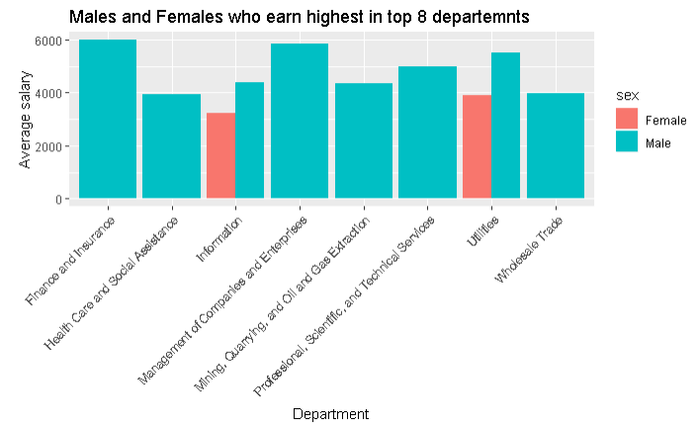
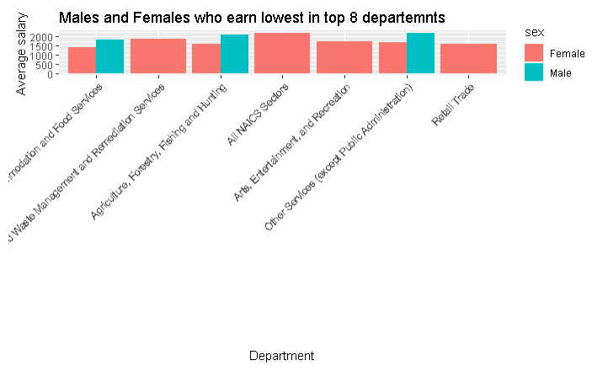
By aggregating, the salary of male and female we sorted the top and bottom eight departments with highest and lowest paid in Miami Dade County. We can observe that there are few females in top eight departments and more females in lowest paid jobs.

Slide 14
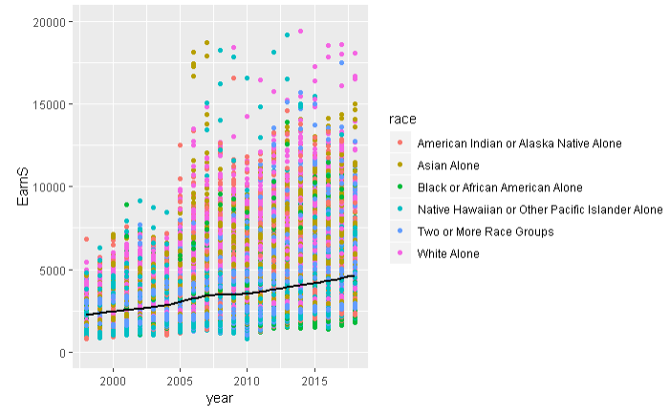
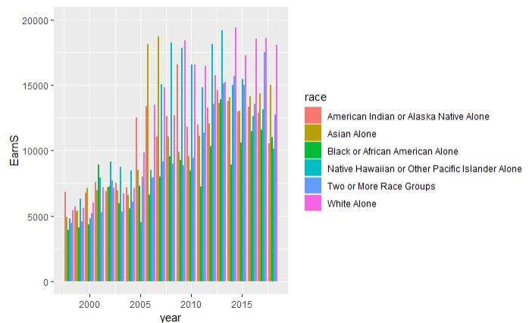
Demography pay gap-time series analysis
While factual proportions of compensation disparity between dark people and their white partners exist, wage imbalance is still inadequately comprehended because of an absence of writing with strong exact information to connect information with a precise model of pay segregation.
The charts shows the monthly salary by racial group.

Slide 15
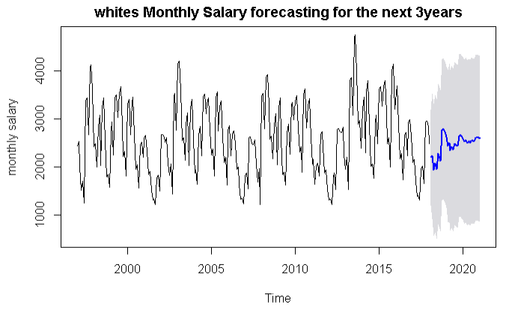
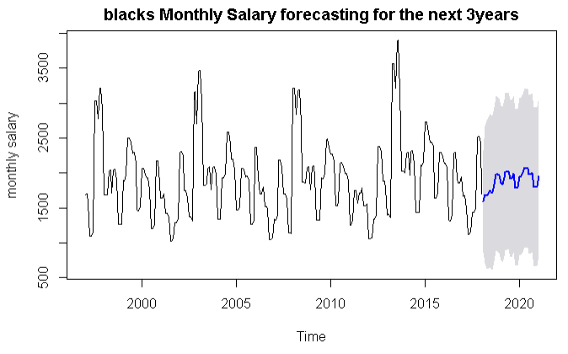
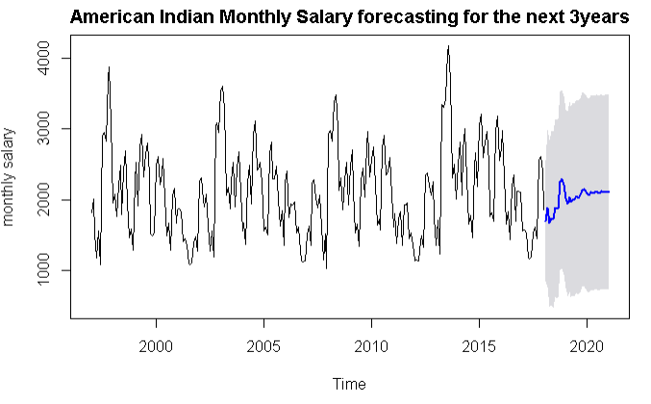
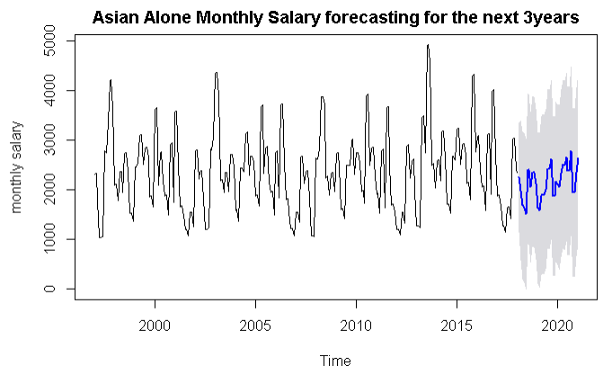
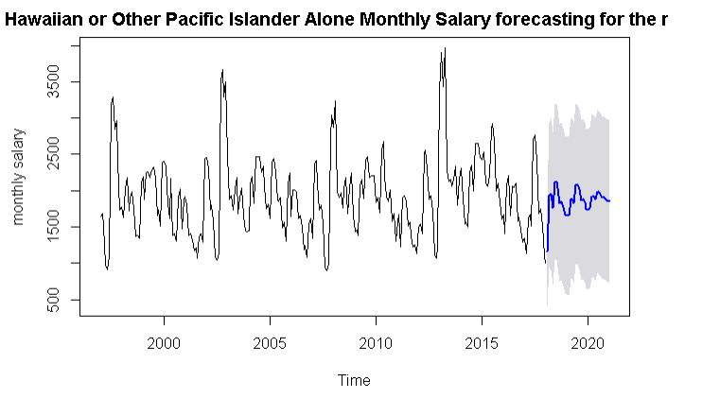
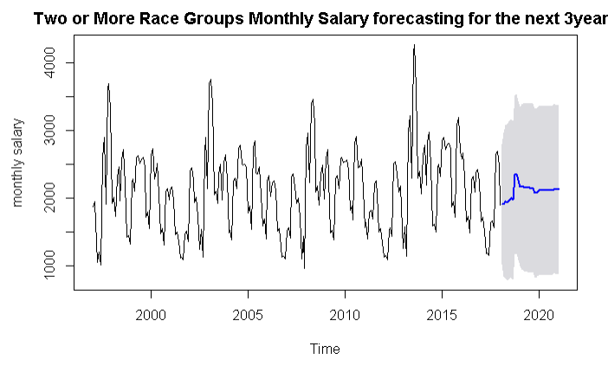
Time series Analysis for Demography

Slide 16
Calculations:
The earnings ratio and the gender pay gap is calculated for year 2020, using these formulas:
Earnings ratio = women’s earnings /men’s earnings
=1337.244/2391.5799
= 0.55914*100=55.914%
Pay gap= [(men earnings-women earnings)/men earnings]*100
=[( 2391.5799-1337.244)/2391.5799]*100
= 0.4408*100= 44.08 %
There is 44%pay gap between male and female in Miami Dade County.
Pay gap by Racial group:
Prediction of wages among all races are calculated and it was observed that white people get highest among all races .
Whites vs Blacks = 31%
Whites vs American Indian = 19%
Whites vs Asian = 10%
Whites vs Native Hawaiian = 29%
Whites vs Two more races = 19%

Slide 17
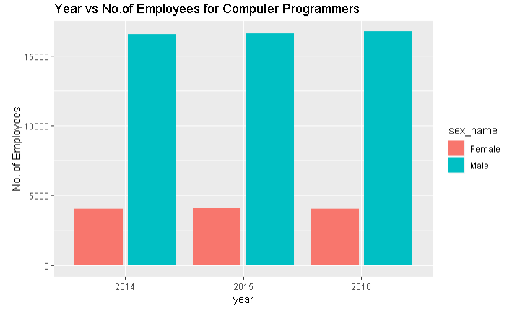
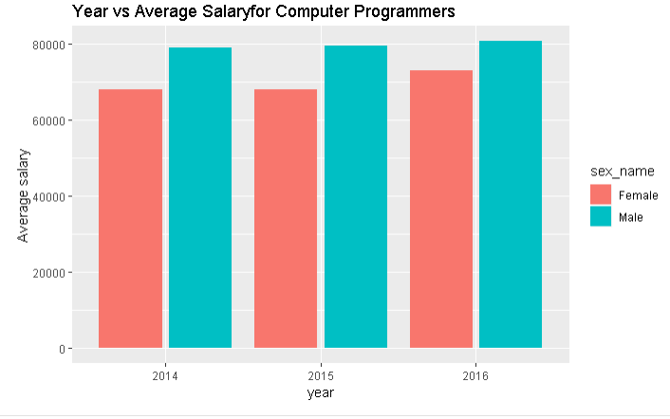
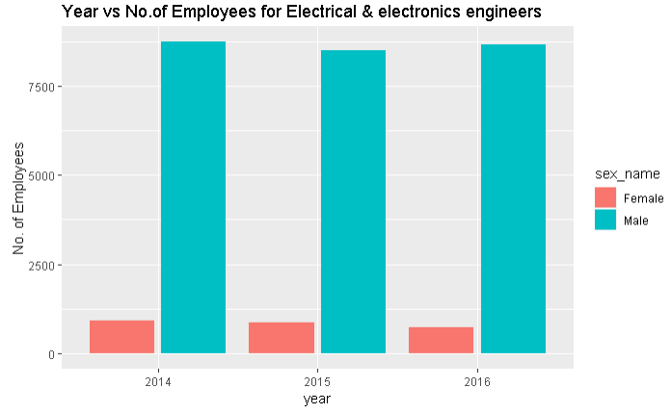
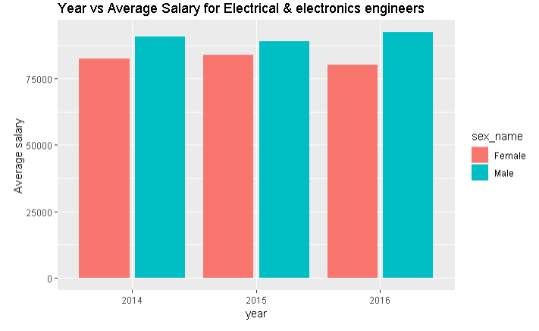
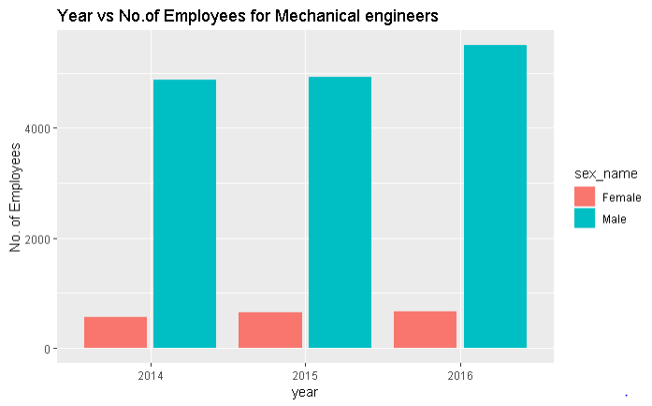
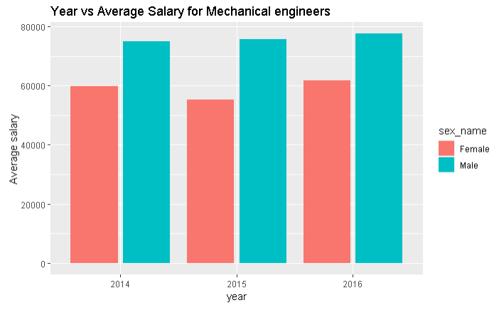
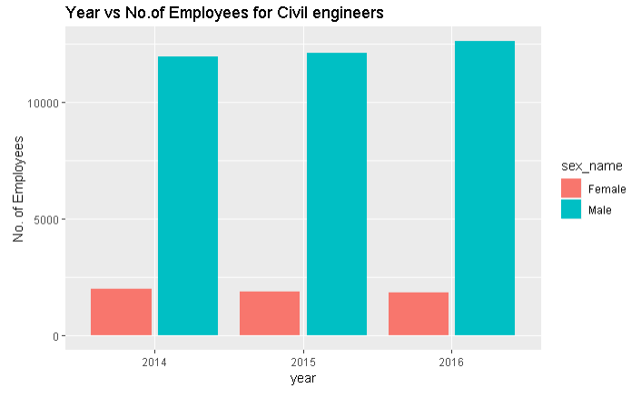
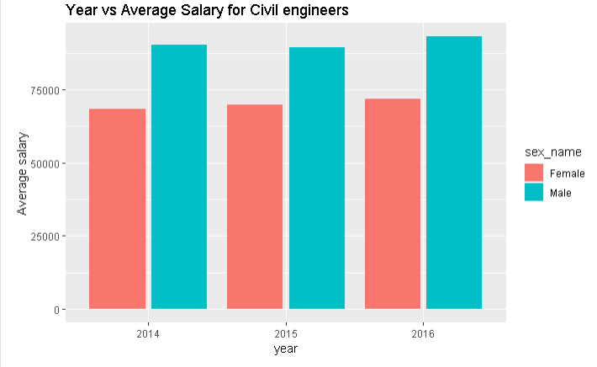
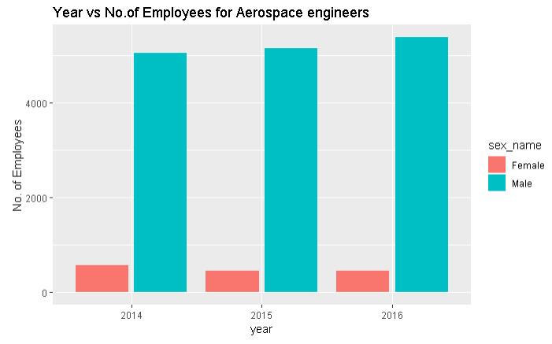
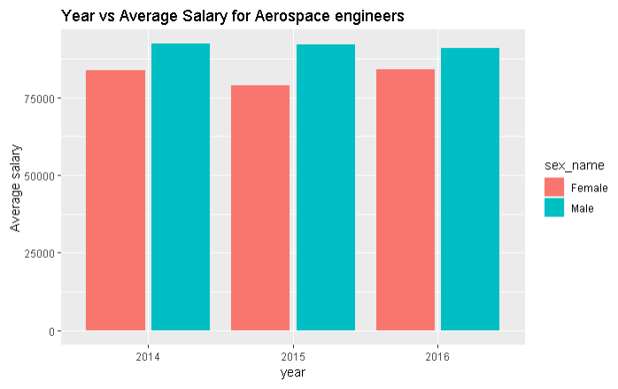
Bias Within Job Classes: Computer programmers, Mechanical engineers, Electrical & electronics, Civil engineers, Aerospace engineers

Slide 18
Results: Prediction
Predicted mean for unemployment and gender
Predicted mean for Demography
year | unemployment rate | monthly salary for both genders($) | male monthly salary($) | female monthly salary($)
2018 | 3.805754 | 1498.338 | 2704.6827 | 1672.656
2019 | 3.451452 | 2023.74 | 2097.5065 | 1948.803
2020 | 3.184723 | 1756.245 | 2391.5799 | 1607.044
2021 | 2.990021 | 2024.609 | 2321.5901 | 1749.507
2022 | 2.845611 | 1870.168 | 2328.1066 | 1611.062
Year | Whites | Blacks | American Indian | Asian | Native Hawaiian | Two or more races
2018 | 2735.714 | 1963.285 | 2209.224 | 2123.790 | 1668.979 | 2269.647
2019 | 2636.112 | 1796.690 | 2129.658 | 2162.898 | 1754.709 | 2090.901
2020 | 2603.66 | 1808.080 | 2104.084 | 2349.654 | 1854.058 | 2128.060

Slide 19
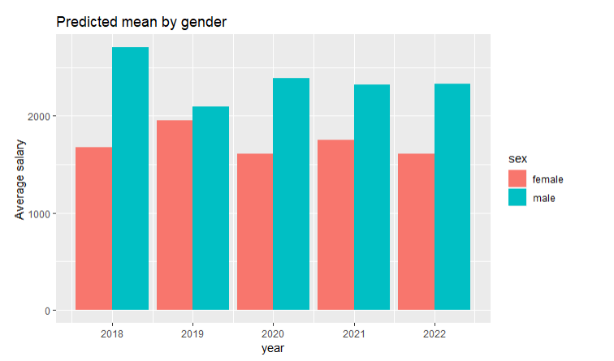
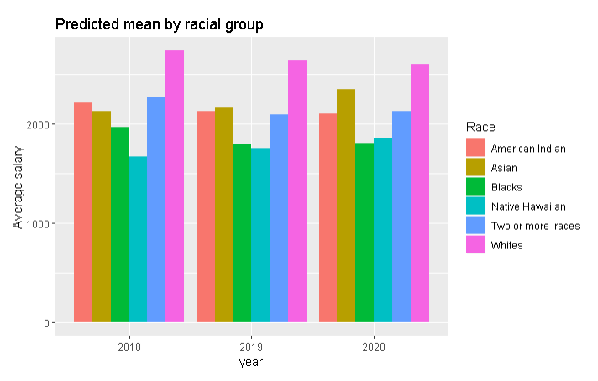
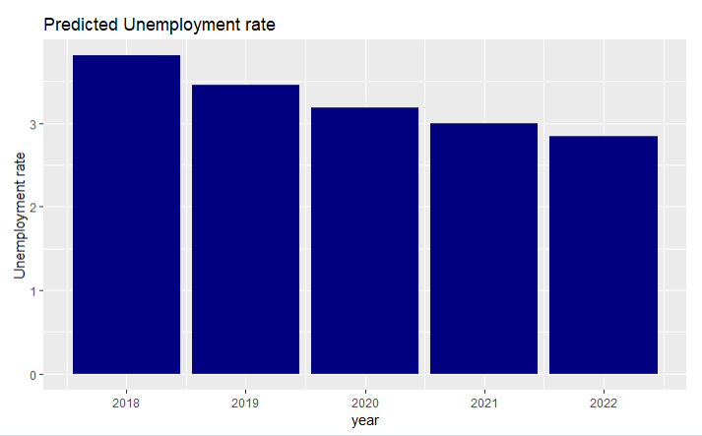

Slide 20
Prescription::
Based on the analysis, by 2022 there will be a decrease in Unemployment rate of 2.84 %. Even then, gender wage gap still exits.
There is a 44% gender wage gap between male and female, which represents that the men’s salary is 1.78 times of women’s salary from which one can deduce that for every dollar man earns, a woman earns 56 cents.
Therefore, the prescription for Miami-Dade County would be to either increase female wages by 44% to bridge the pay gap, which would exist until 2020 or hire more female employees in the above-mentioned (Figure. 14) departments such that the amount of female workers is evident among men workers.
Moreover, the gap present on racial grounds is the highest among blacks and whites, which needs to be curtailed.

Slide 21
References:
R. Oaxaca, “Male–female wage differentials in urban labor markets”, International Economic Review , vol.14(3), pp. 693–709, 1973.
S.B Jarrell, and Stanley, “Declining bias and gender wage discrimination? A meta-regression analysis”, Journal of Human Resources, vol. 39(3), pp. 828–838 , 2004.
F. Bettio, “The pros and cons of occupational gender segregation in Europe”, Canadian Public Policy, vol. 28, S1, pp. 65–84, 2002.
F.D Blau, and L.M Kahn, “Understanding international differences in the gender pay gap”, Journal of Labor Economics, vol. 21(1), pp. 106–44, 2003.
M. Brynin, and F. Perales, “Gender wage inequality: the de-gendering of the occupational structure”, European Sociological Review, vol. 32( 1), pp. 162-74, 2016.
H. Joshi, G. Makepeace, and P. Dolton, “More or less unequal? Evidence on the pay of men and women from the British Birth Cohort Studies”, Gender, Work and Organization, vol. 14(1), pp. 37-55, 2007.

Slide 22

THANK YOU

Slide 23
Any Queries?

